Slide 1
Practice Questions
CPM

Slide 2
Scenario: Office Building Construction
BuildRight Construction is managing an office building project with the following activities:
Activities & Durations:
A: Site Preparation (2 weeks)
B: Design Finalization (3 weeks)
C: Structural Approval (2 weeks)
D: Foundation Construction (4 weeks)
E: Steel Framework (4 weeks)
F: Utilities Installation (3 weeks)
G: Main Structure Assembly (5 weeks)
H: Final Inspection (2 weeks)

Slide 3
Dependencies:
Start → A, B
A → D
B → C
C → E
D → F
E → G ✓
F → G ✓
G → H
H → Finish

Slide 4
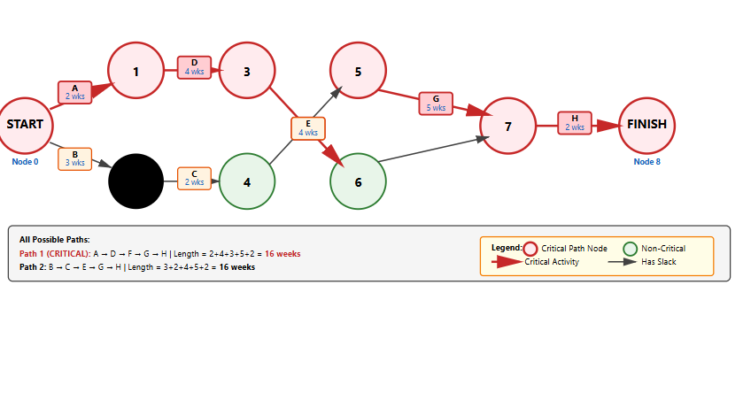

Slide 5
Draw the complete network diagram showing all activities, nodes, and dependencies. Label each activity with its duration.
Q2. Using Forward Pass method, calculate the Early Start (ES) and Early Finish (EF) for each activity. Show your calculations.
Q3. Identify ALL critical path(s) and determine the minimum project completion time.

Slide 6
Slack = LS − ES
Slack = LF − EF
Both give the same result.
To compute slack, we must first complete the Forward Pass (to find ES & EF) and Backward Pass (to find LS & LF).
✓ LF of H = 16 (project deadline)
✓ LS of H = LF - Duration = 16 - 2 = 14

Slide 7
Step 1: Forward Pass (ES & EF)
Rules:
ES (Earliest Start) = maximum EF of all predecessor activities
EF (Earliest Finish) = ES + Duration
Forward Pass (ES/EF): Shows the fastest possible schedule
Backward Pass (LS/LF): Shows how late activities can run
Slack = LS - ES: Shows flexibility (zero slack = critical activity!).
Slack = The amount of time an activity can be DELAYED without delaying the project

Slide 8
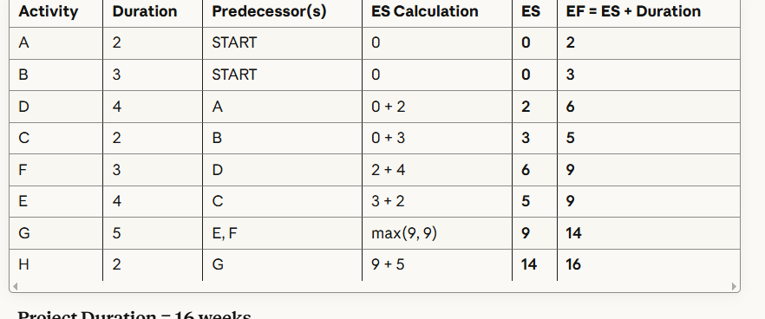
Project Duration = 16 weeks

Slide 9
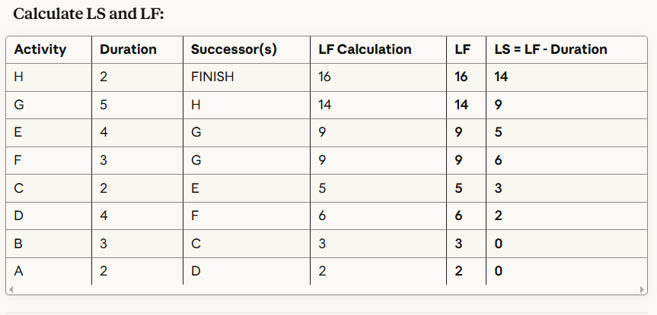
Backward Pass

Slide 10
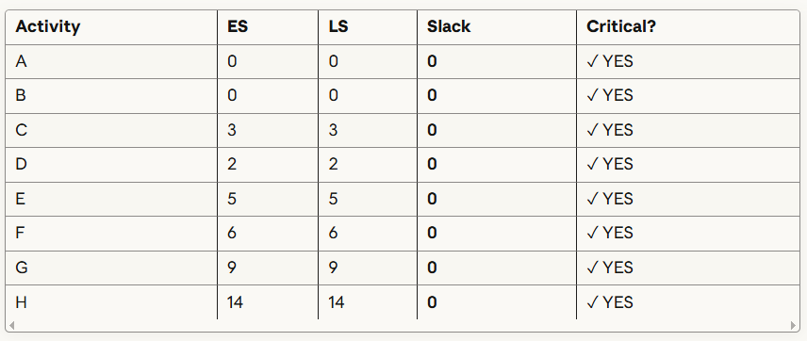

Slide 11
Slack = LS - ES (or LF - EF)
If Slack = 0 → CRITICAL activity ⚠️
If Slack > 0 → NON-CRITICAL activity ✓

Slide 12
Suppose we are analyzing a Library Management System.
Functional Components:
External Inputs (EI): 10 (e.g., book entry, student registration, borrow/return transaction) → weight = 4
External Outputs (EO): 5 (e.g., overdue report, fine summary) → weight = 5
External Inquiries (EQ): 8 (e.g., search book, check borrower details) → weight = 4
Internal Logical Files (ILF): 7 (e.g., Books file, Students file) → weight = 10
External Interface Files (EIF): 2 (e.g., integration with external catalog API) → weight = 7
(Weights used: average complexity values from standard FPA tables).

Slide 13
Characteristic | Rating
Data communications | 3
Distributed data processing | 2
Performance | 4
Heavily used configuration | 3
Transaction rate | 2
Online data entry | 3
End-user efficiency | 4
Online update | 3
Complex processing | 4
Reusability | 2
Installation ease | 1
Operational ease | 2
Multiple sites | 3
Facilitate change | 4

Slide 14

TCF=0.65+(0.01×40)=0.65+0.40=1.05
Adjusted Function Points (AFP)
$$AFP=UFP×TCF=181×1.05=190.05≈190$$

